Slide 1

Online Student Counselling System
Submitted By
Md Sharifuzzaman Shajib
Id No: 18CSE032
Department of CSE, BSMRSTU
Submitted To
Md. Martuza Ahamad
Assistant Professor
Department of CSE, BSMRSTU
Bangabandhu Sheikh Mujibur Rahman Science and Technology University, Gopalganj
July 19th 2023

Slide 2
Table of contents:
Introduction
Purpose
Goal
Modules
Requirements
Overall Description
Technology Stack
Usecase-Diagram
Screenshots of my website

Slide 3
Introduction
The name of my project is “Online Student Counselling System”
That provides virtual counseling and support services to students. It utilizes digital technologies and communication tools to connect students with trained counselors and mental health professionals remotely
With this website, a student can get help of an expert counsellor from the comfort of his/her home and with absolute privacy.

Slide 4
Purpose
The main objective of our project is to help students who are facing problems related to academics or college life like stress, peer pressure, problem in deciding their goal, poor performance in studies etc. by providing expert guidance from our counsellors.

Slide 5
Goal
The primary goal of an online student counseling system is to promote and enhance the mental well-being of students.
It addresses a wide range of concerns, including academic stress, anxiety, depression, relationship issues, career guidance, and personal development.
By providing confidential and professional counseling services in a virtual setting, these systems strive to remove barriers to accessing support, such as geographical constraints, stigma, and scheduling conflicts.

Slide 6



Modules
There are three types of modules of our website:
Admin
Counsellor
Student
The admin manages all activities happening on the website like :
i. Approving a newly registered counsellor.
ii. Viewing and deleting feedbacks or profiles etc.
Counsellor is an expert who helps students in any way they need help.
Student reach out to the counsellors for help.

Slide 7
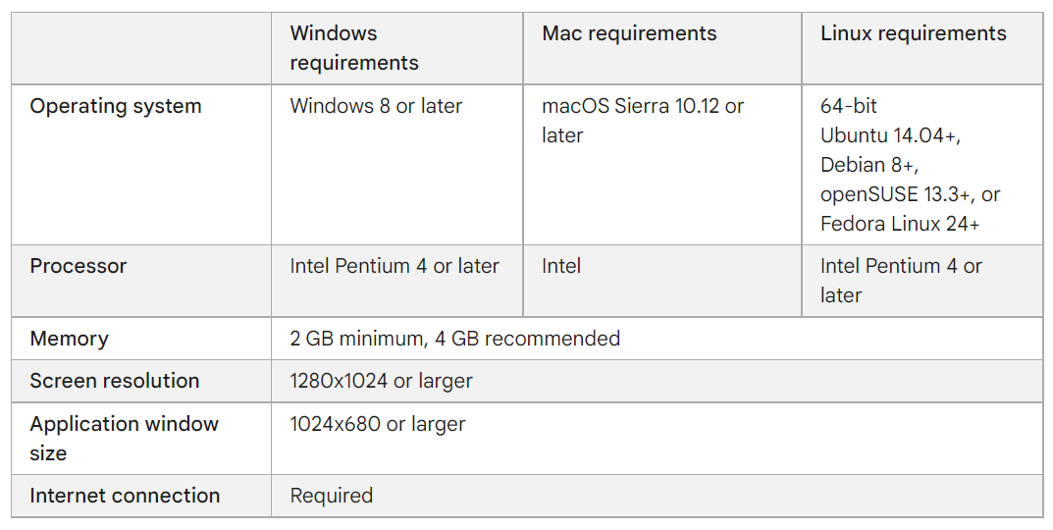
Requirements
A web browser and

Slide 8
Overall Description
Functional Modules
1. Student Module -
Student can apply to take counselling .
Student can view all registered counsellors.
Student have the ability to edit their profile.
2. Counsellor Module -
Counsellor can view the details of all students.
Counsellor also give feedbacks.
3. Admin Module -
Admin can approve, delete or edit a counsellor’s or students account.
Admin can change the questions and their options.

Slide 9
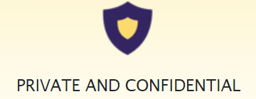
Overall Description
External Interface requirements
A user to operate the website.
All the system requirements mentioned previously.
A web browser (eg. Google chrome, mozilla firefox, brave etc.)
Non-functional requirements
Performance : This is a fast website.
Security : It provides complete privacy.
Quality : It has a clean UI with good UX.

Slide 10





Technology Stack
Frontend
HTML
CSS
Bootstrap
JavaScript
Backend
PHP
Database
MySQL

Slide 11
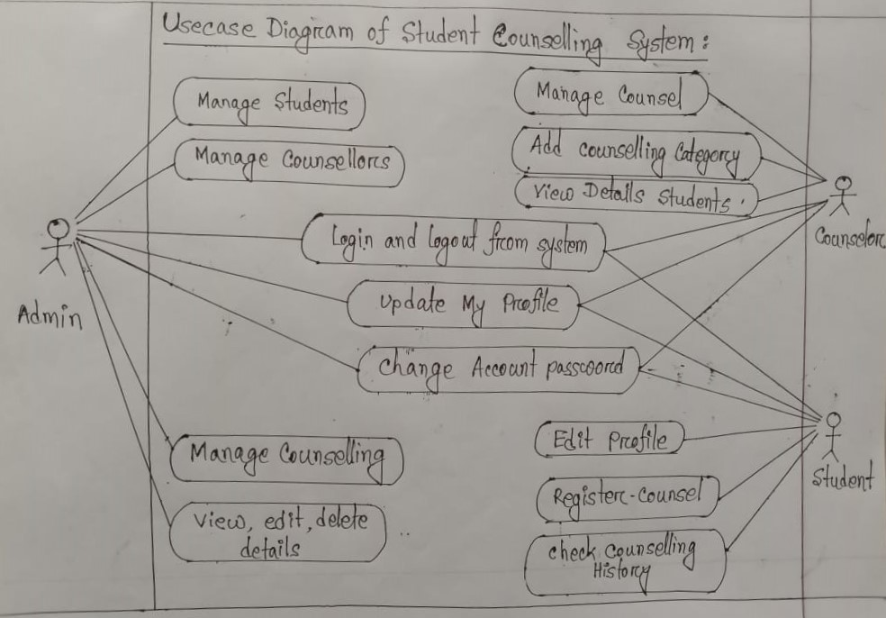
Usecase-Diagram

Slide 12
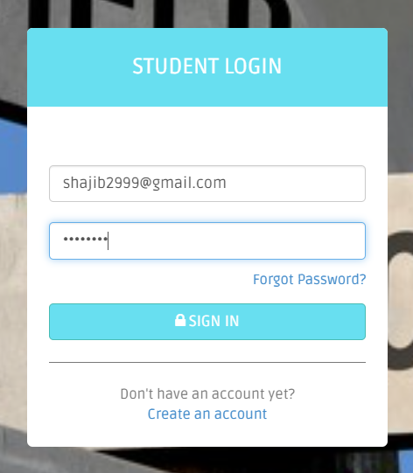
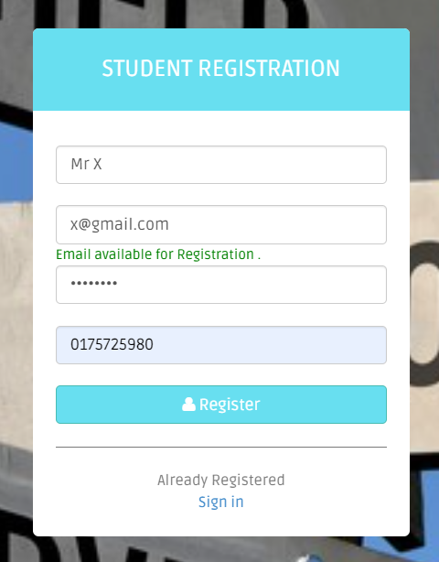
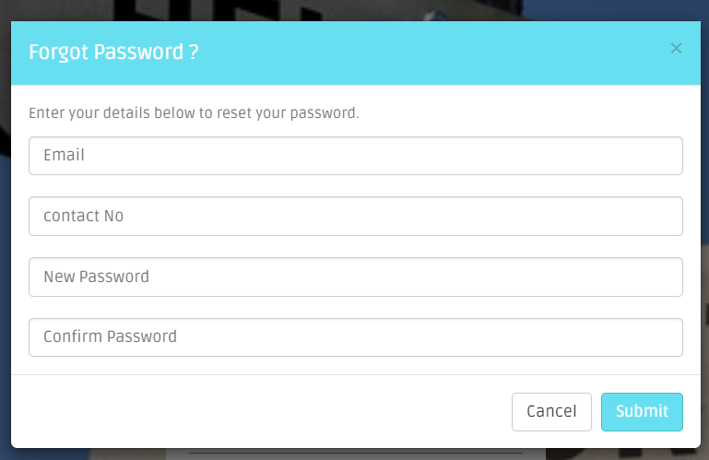
Screenshots of my website

Slide 13
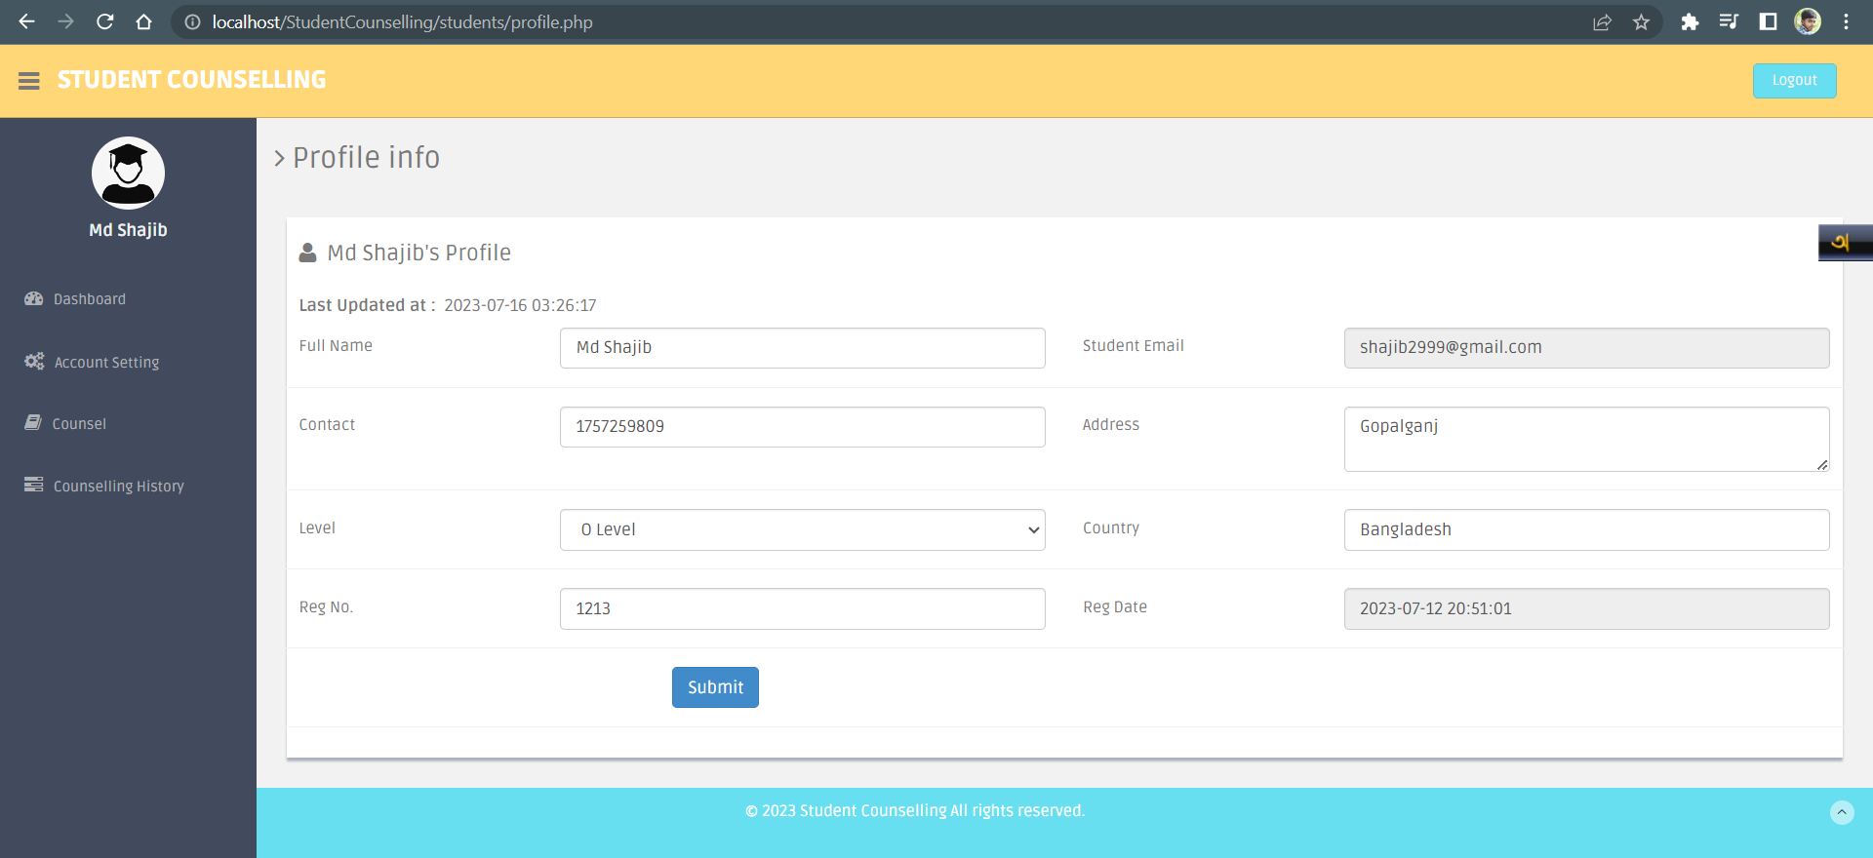
Screenshots of my website

Slide 14
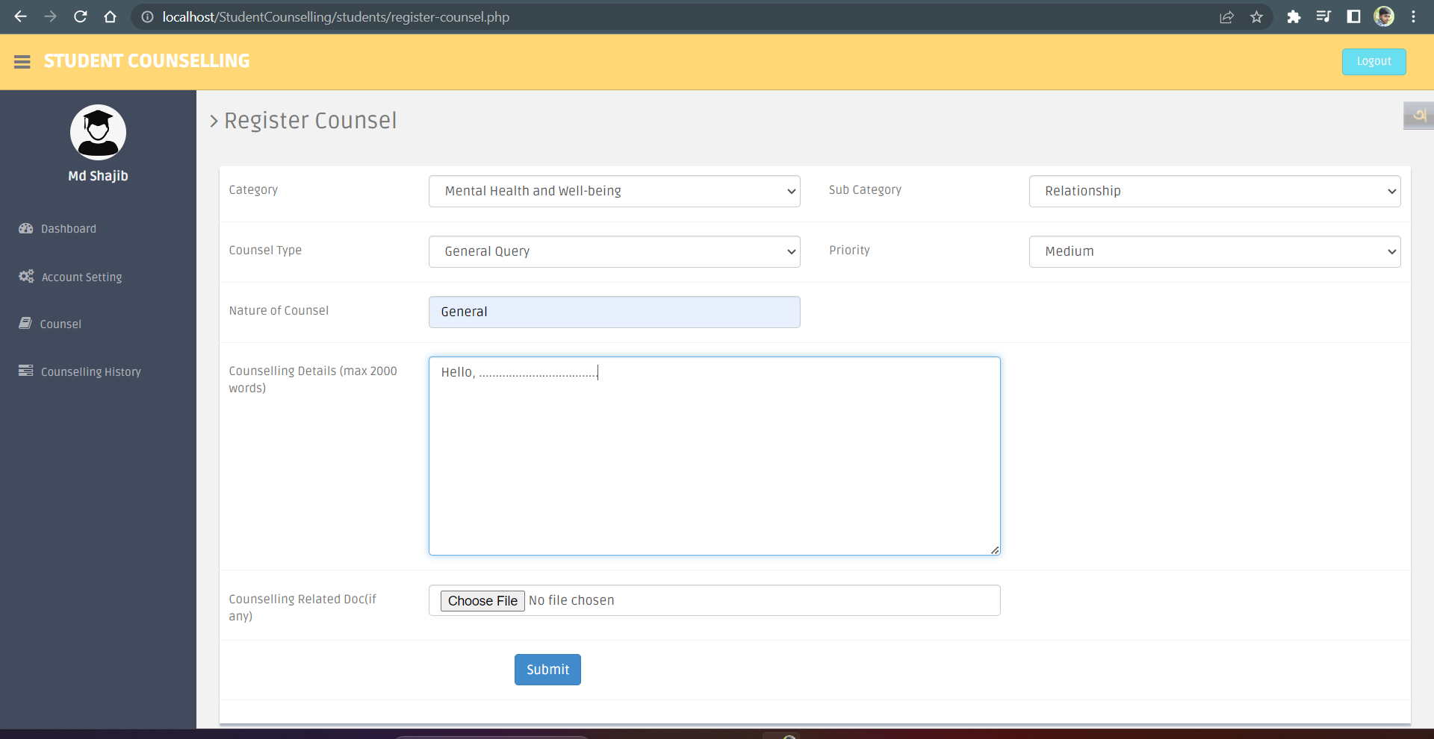
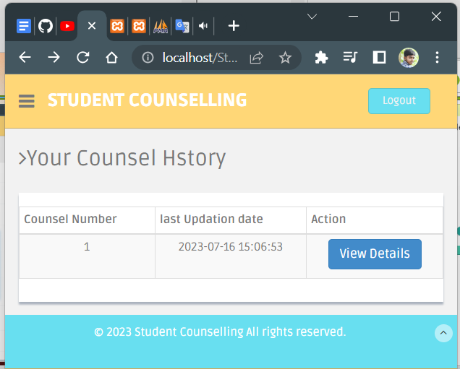
Screenshots of my website

Slide 15
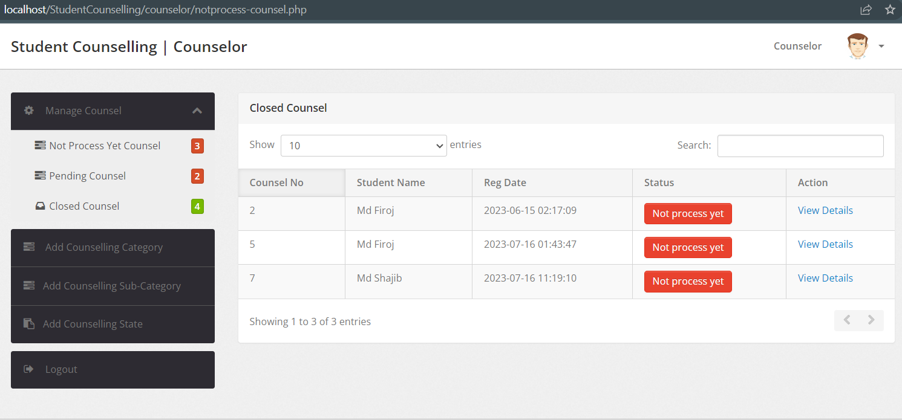
Screenshots of my website

Slide 16
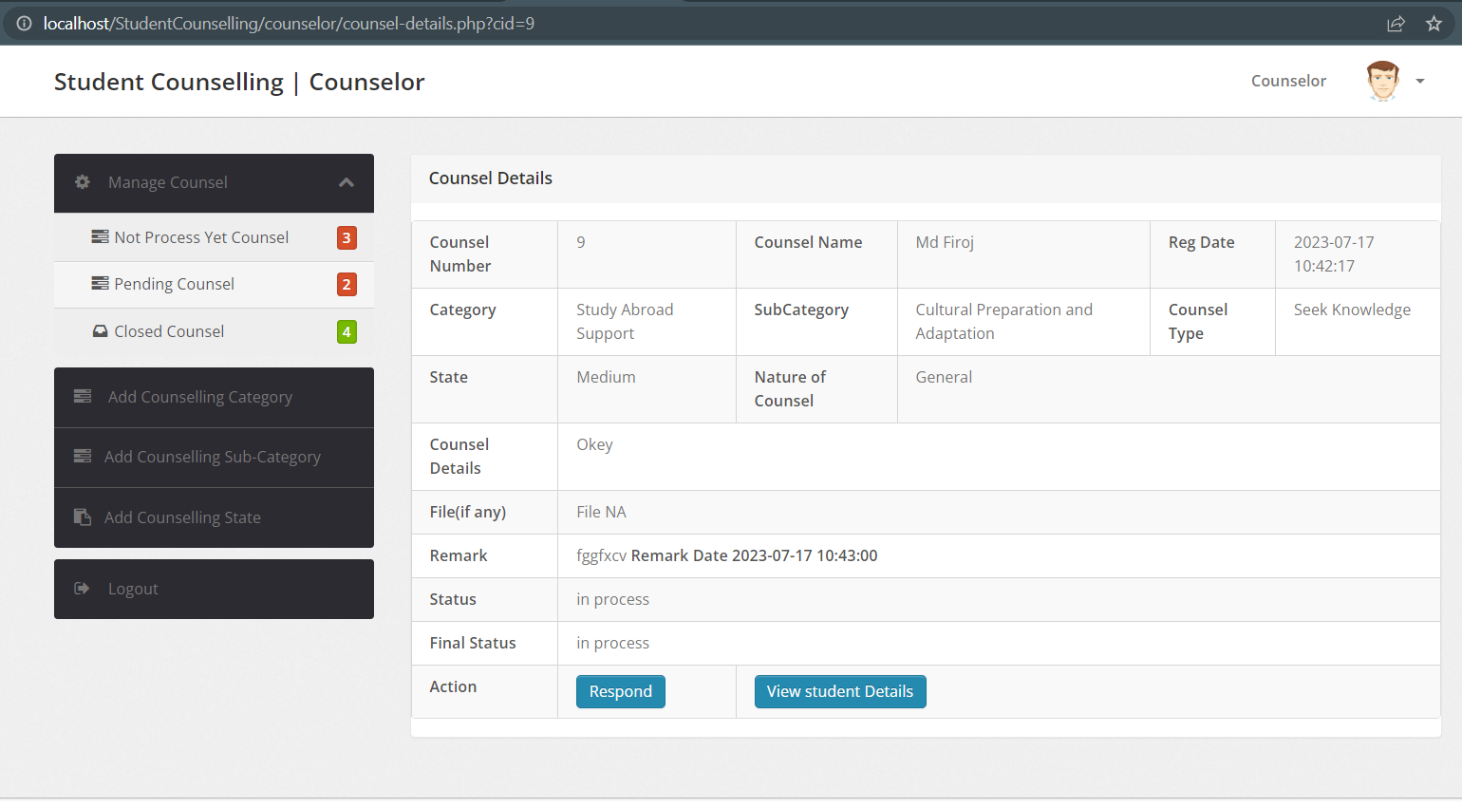
Screenshots of my website

Slide 17
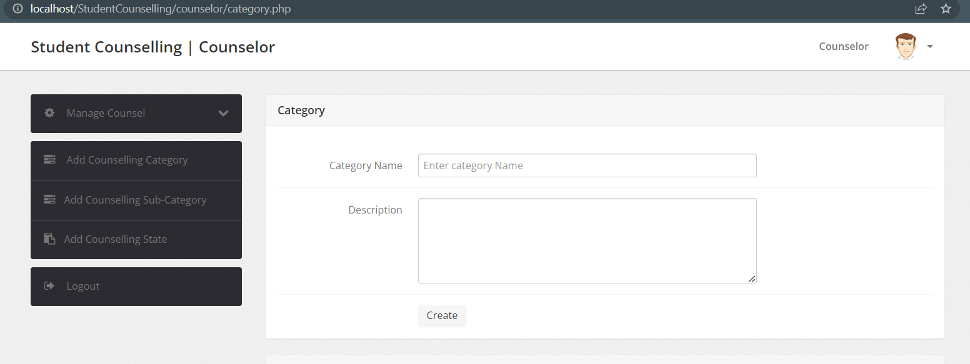
Screenshots of my website

Slide 18
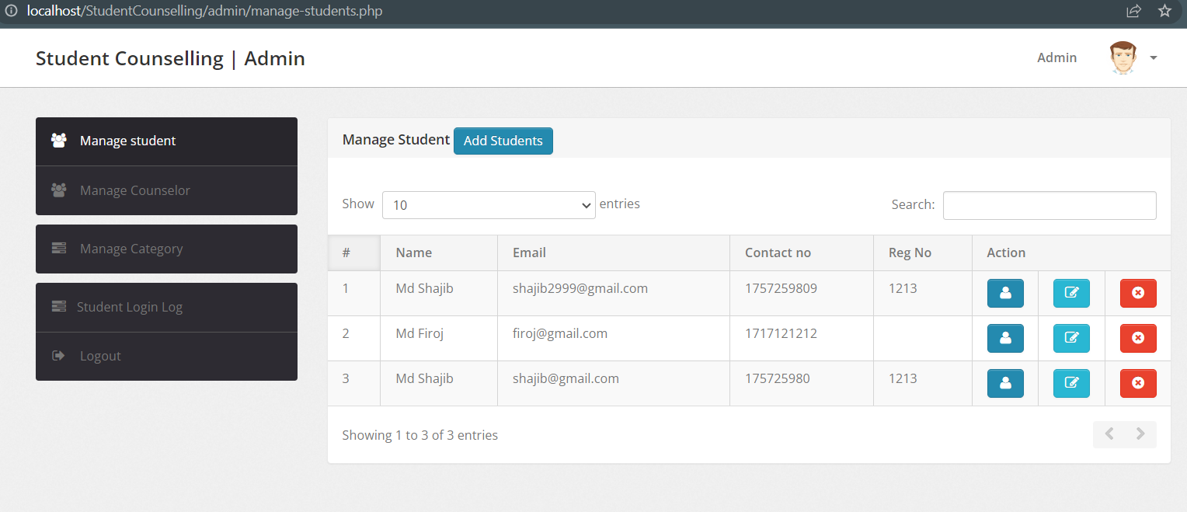
Screenshots of my website

Slide 19
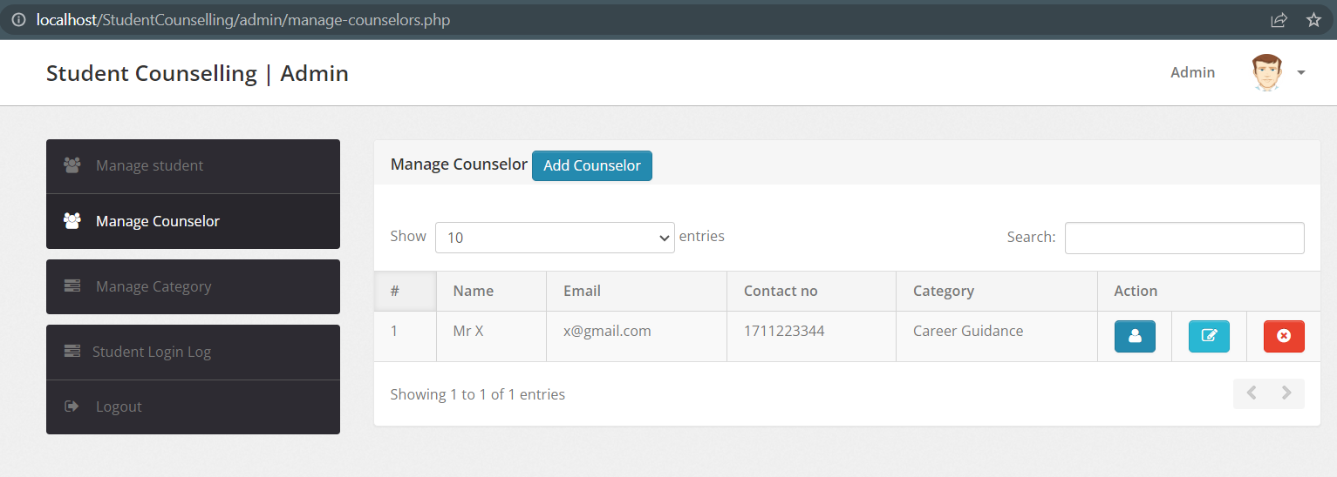
Screenshots of my website

Slide 20
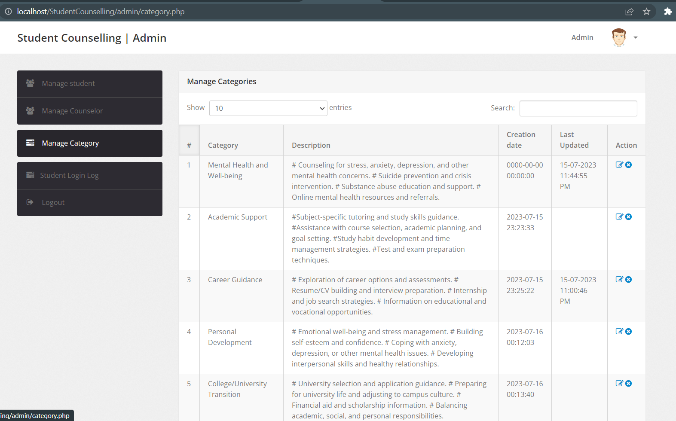
Screenshots of my website

Slide 21
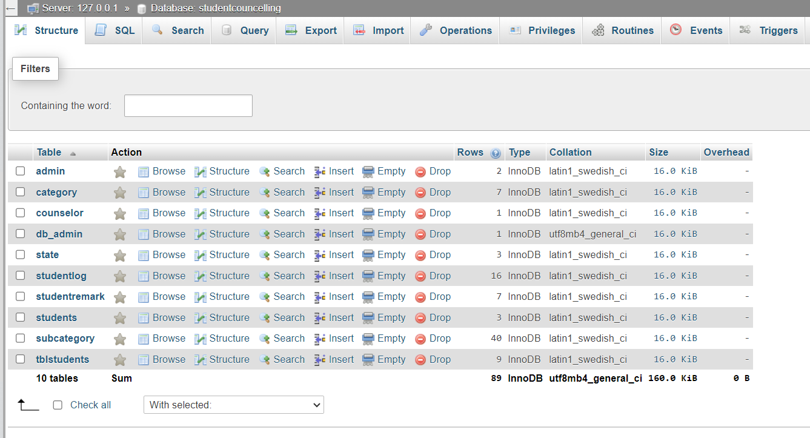
MySQL Database

Slide 22

Thanks!

